Slide 1
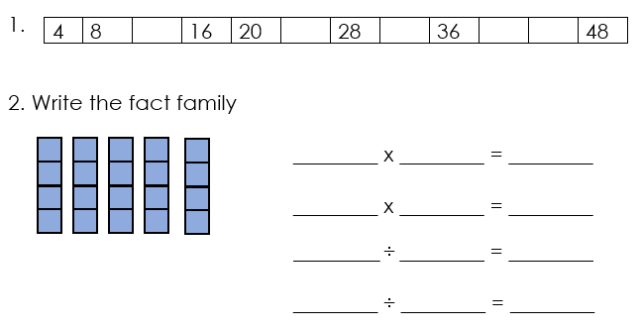

Slide 7
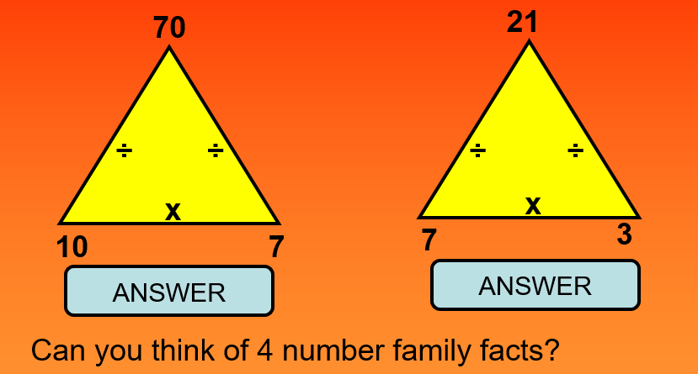

Slide 10
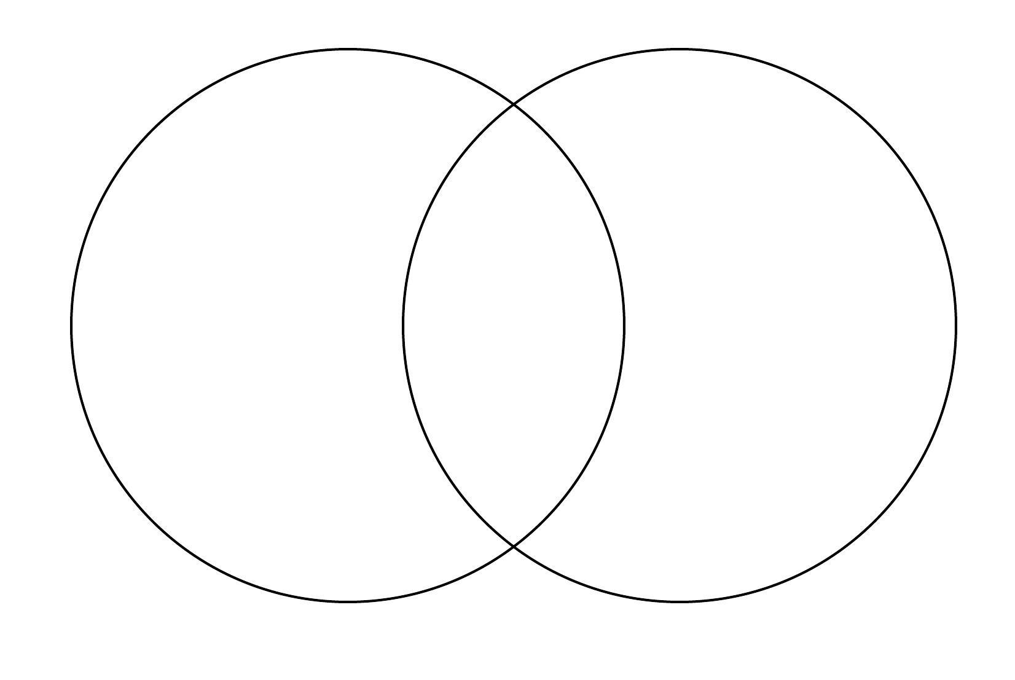

Slide 11
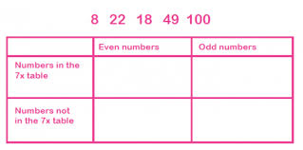

Slide 12
Multiplying using grid method and partitioning.

Slide 13
Solve: 15x2
How did you do it?
You may have known that 15x2=30
Or you may have partitioned:
10x2=20
5x2=10
20+10=30
Partitioning breaks the number into smaller chunks, making it easier to work with.

Slide 14
Solve 12x3
Partition 12
10
2
Then multiply each part by 3
10x3=30
2x3=6
30+6=36

Slide 15
Grid method
We can use a written method to help us.
12x3=
Partition the number along the top
x
10
2
Place the multiplier down the side
3
30
6
Add your answers- 30+6=36

Slide 16
Grid method
We can use a written method to help us.
21x3=
Partition the number along the top
x
20
1
Place the multiplier down the side
3
60
3
Add your answers- 60+3=63

Slide 17
Grid method
212x3=
Partition the number along the top
x
200
10
2
Place the multiplier down the side
3
600
30
6
Add your answers- 600+30+6=636

Slide 18
Grid method
127x4=
Partition the number along the top
x
100
20
7
Place the multiplier down the side
4
400
80
28
Add your answers- 400+80+28=508

Slide 19
24 x 3
32 x 4
16 x 5
9 x 12
14 x 6
7 x 13
14 x 4
32 x 6
18 x 8
25 x 4
22 x 6
19 x 8
31 x 3
35 x 2
224 x 3
332 x 4
136 x 5
9 x 121
104 x 6
7 x 143
147 x 4
325 x 6
183 x 8
257 x 4
225 x 6
197 x 8
314 x 3
358 x 2
If a baker bakes 152 loaves of bread every day, how many will he have baked in 7 days?
Charlie has packed his soldiers into 4 boxes ready to move house. In each box he has managed to pack 365 soldiers. How many soldiers does Charlie have altogether in the boxes?
For the Oscars, 746 special goody bags have been prepared. Each bag has 6 special presents inside. How many presents has the organiser had to buy for these bags?

